Slide 1

Dayton Power & Light
Forecasting energy usage based on historical usage and weather data.

Slide 2

New Data Viz Team
Matt Garber
Joleen Sterner
Kenneth Idoko
Mary Kilmer
Peter Constantelos

Slide 3
Core Message
Goal: Increase accuracy of on hand energy.
Can we use weather data to forecast the energy consumption?

Slide 4
Brainstorm
What weather indicators are correlated to energy consumption?
How do holidays impact energy consumption?
How does day light savings impact energy consumption?
Does day of week impact energy consumption?
What time frame should we use for energy usage? *Recognizing large shifts in population would impact this.

Slide 5
The Data
Kaggle
Hourly Energy Consumption
By power provider
CSV file
Open Weather Map
Daily weather metrics
City level data
JSON file

Slide 6
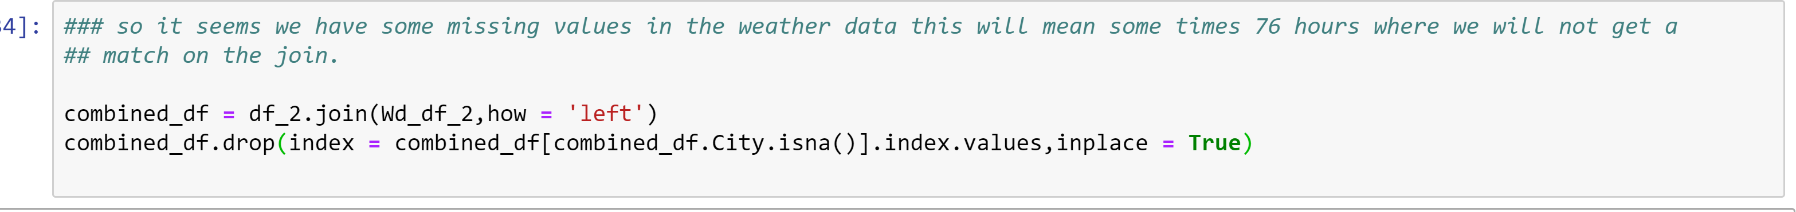
Data Clean Up & Exploration
Data conversions
Build Dictionary
Limit Data to 3 year time frame
Combined data sets

Slide 7
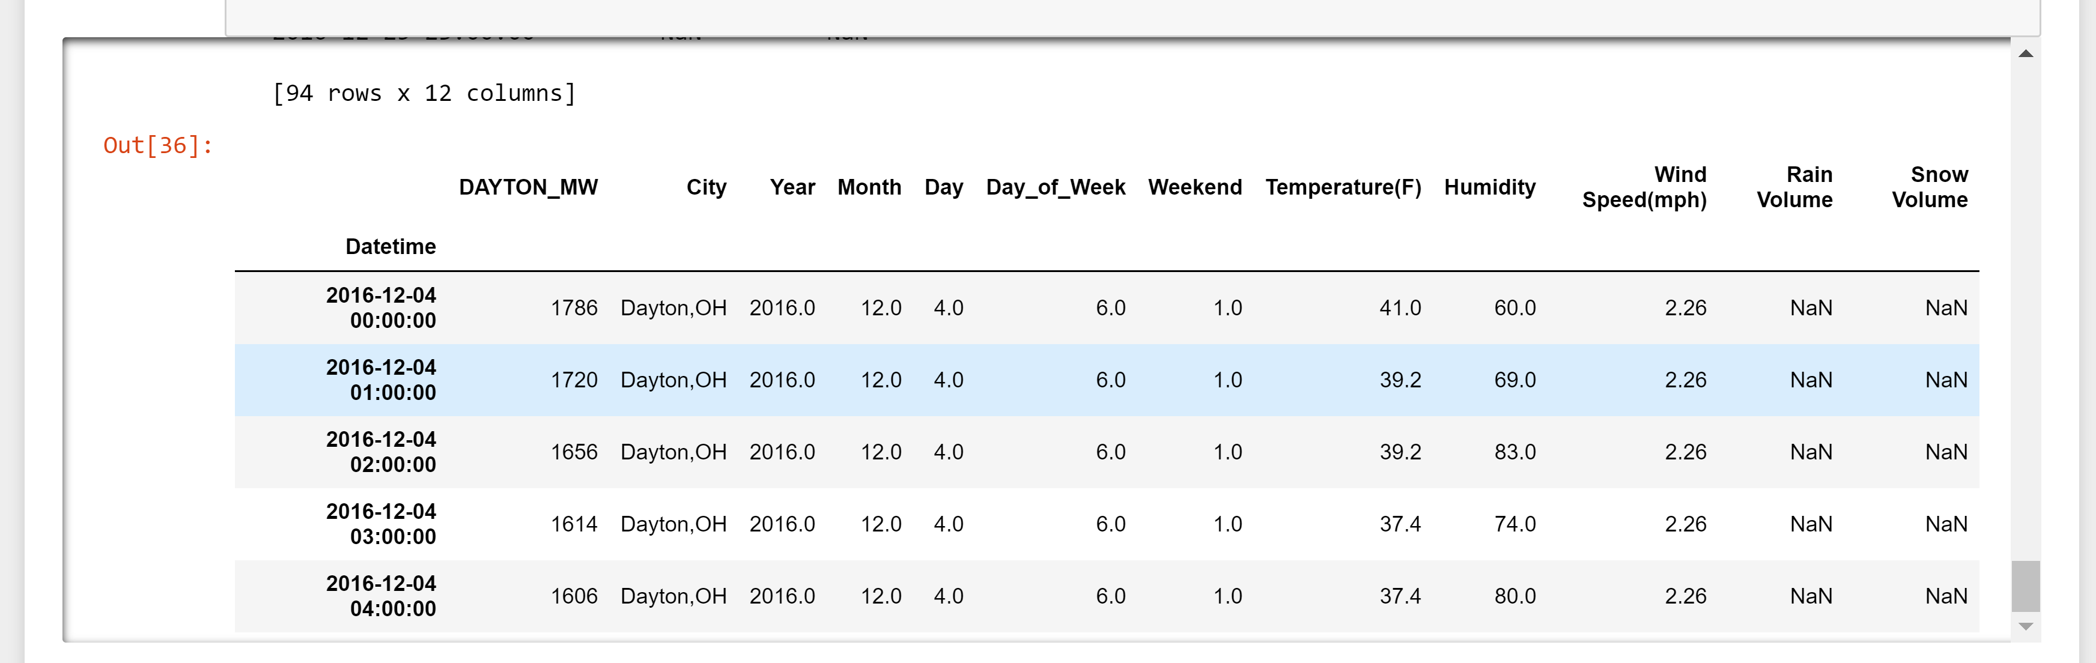
Data Frame

Slide 8
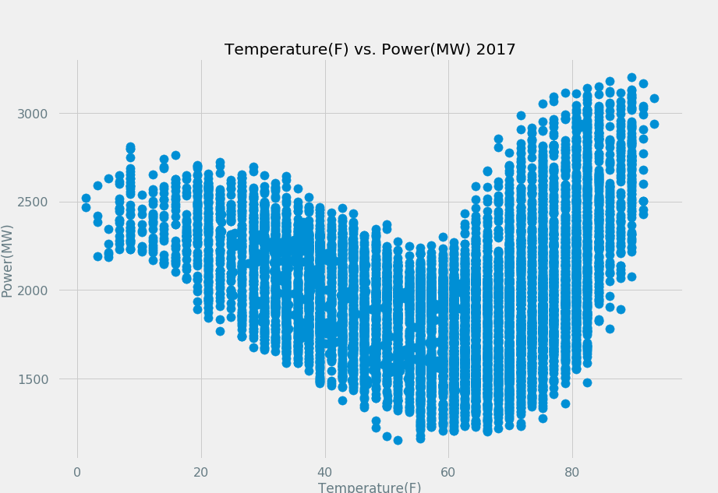
Temp vs Power
Temp and Power 2017 Negative Correlation below 60 degrees and positive correlation above 60 degrees. This plot made us decide to cut the analysis in half above and below 60 degrees.

Slide 9
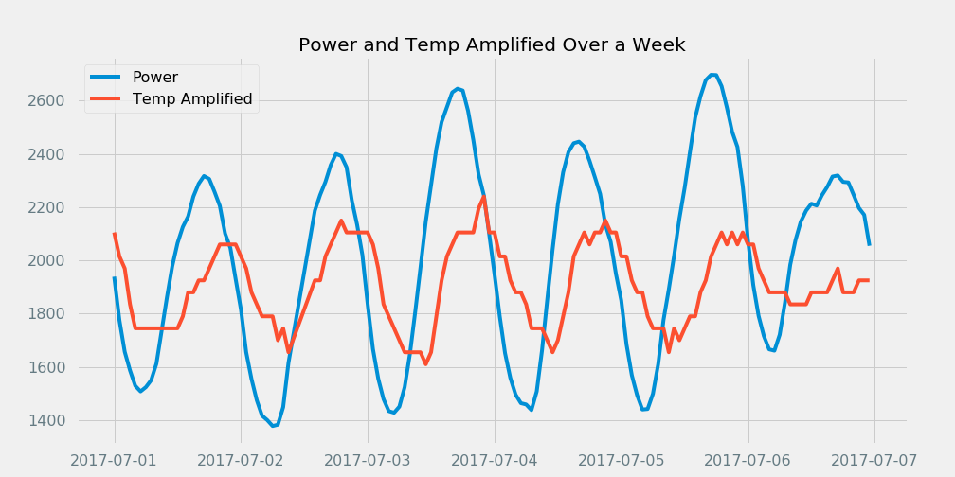
Amplified Power & Temp
Power and Temp line plot over first week in July 2017. Temperature Was Amplified by a factor of 25, nice way to see the relationship

Slide 10
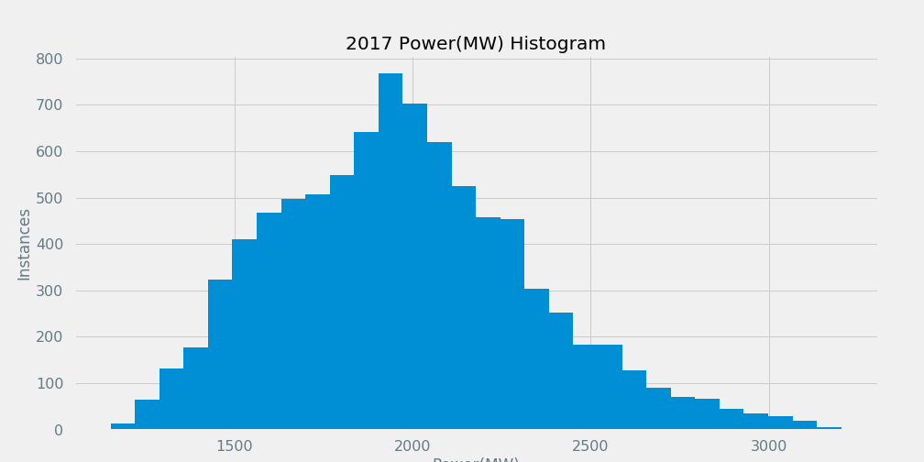
Energy Usage Histogram

Slide 11
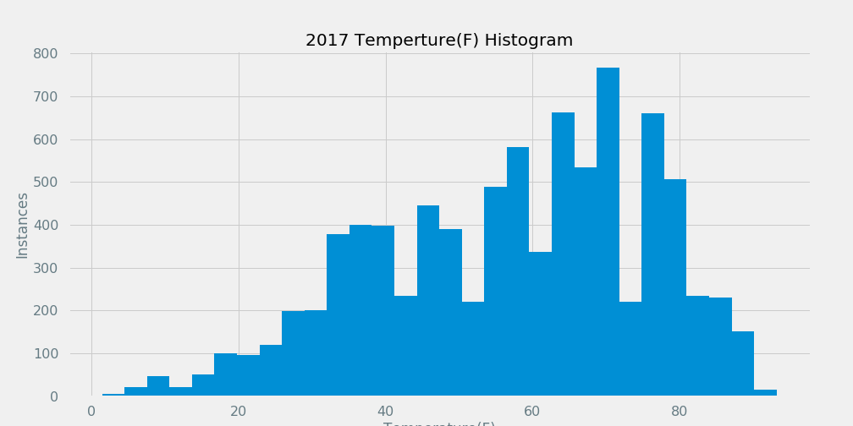
Temperature Usage Histogram

Slide 12
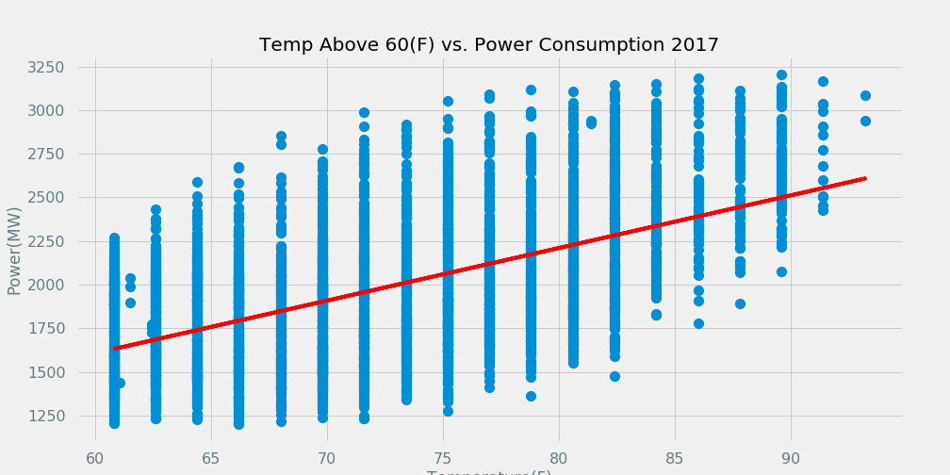
Above 60(F)
Temp over 60 deg linear regression plot. pvalue = 0, correlation coefficient = .57

Slide 13
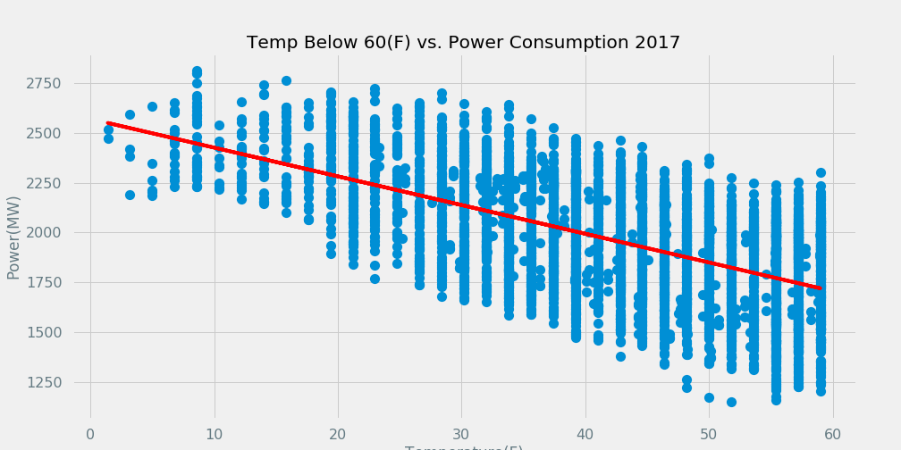
Below 60(F)
Temp below 60 linear regression pvalue = 0.0 correlation coefficient = .59

Slide 14
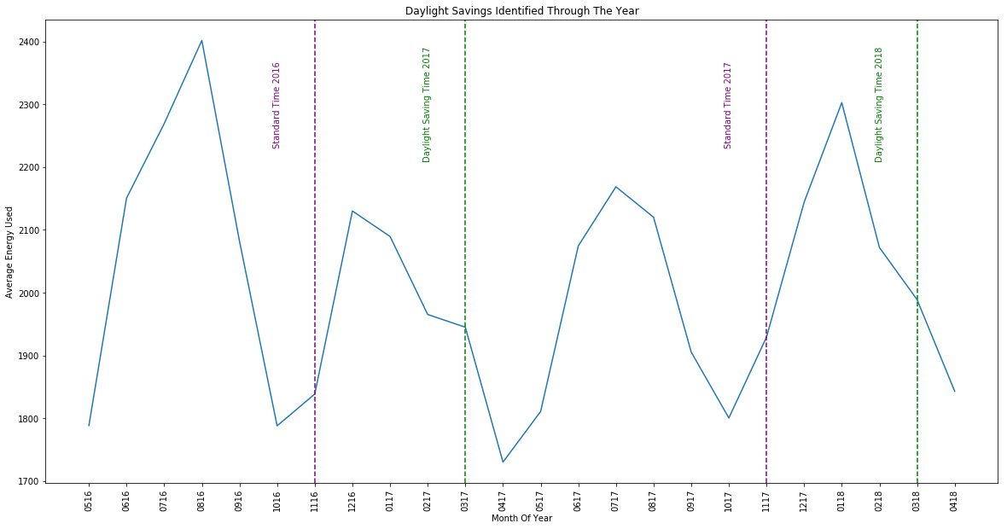
Day Light Saving Analysis

Slide 15
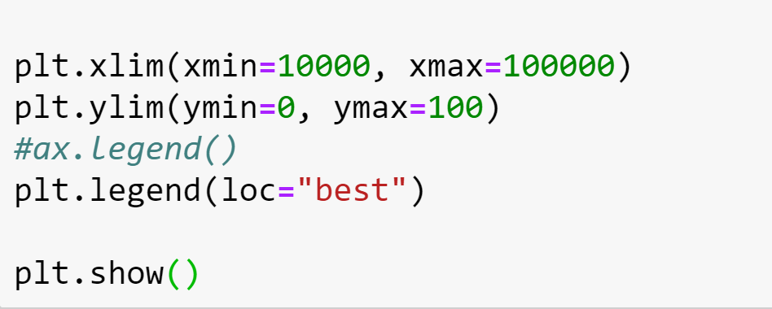
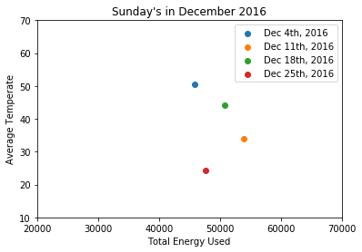
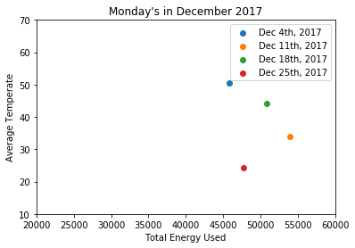
Holiday Analysis

Slide 16
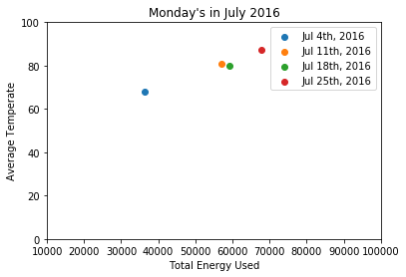
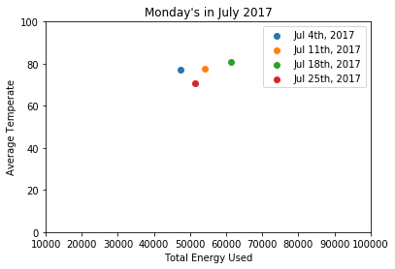
Holiday Analysis

Slide 17
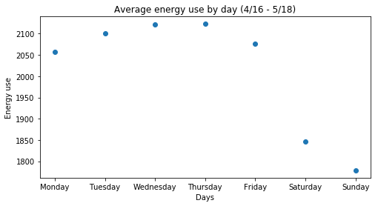
Average Day of Week Analysis

Slide 18
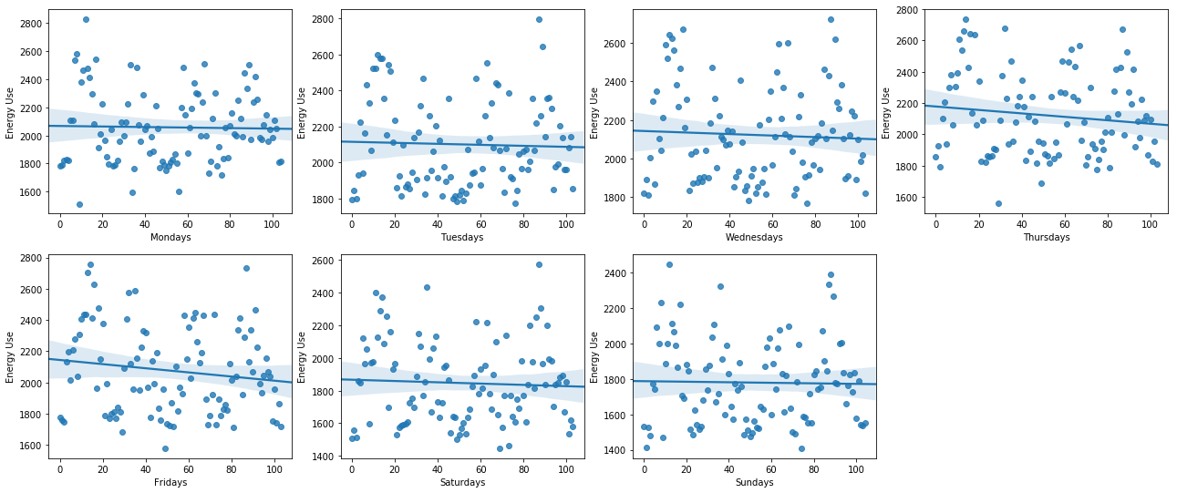
Day of Week Analysis

Slide 19
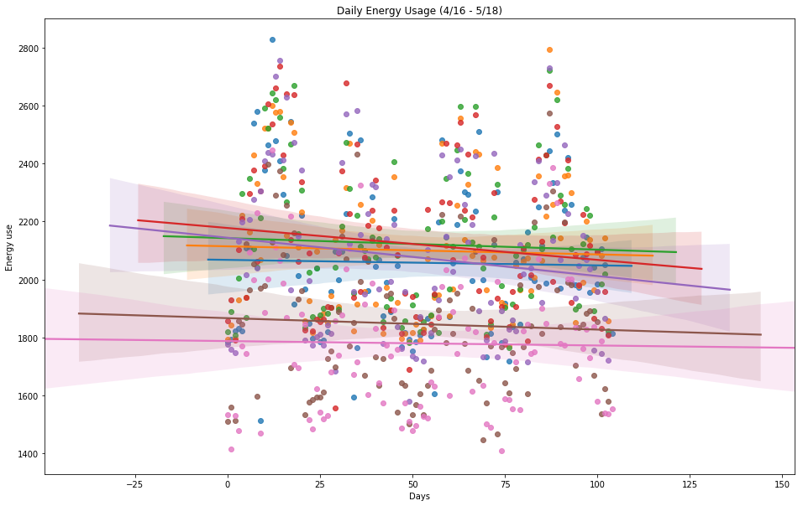
Daily Energy Useage

Slide 20

Brainstorm Findings
What weather indicators are correlated to energy consumption?
How do holidays impact energy consumption?
How does day light savings impact energy consumption?
Does day of week impact energy consumption?

Slide 21
THANK YOU!
Q & A

